Slide 1
CSP554 Big Data Technologies
Module 3a
YARN

Slide 2
Core Hadoop
Hadoop Common
The common utilities that provide basic support to other Hadoop modules.
Hadoop Distributed File System
Enables storage of large amounts of data in redundancy over a cluster of commodity machines,
Zookeeper
A centralized service for maintaining Hadoop cluster configuration information, naming and providing distributed synchronization
Hadoop YARN:
A framework that takes care of cluster resource management and job scheduling tasks

Slide 3
Hadoop Architecture Landscape
Data Exchange
Data Access & Processing
Security
Operations
Sqoop
(DB Data Exchange)
Tools
(Hive, Pig, …)
Ranger
(Security Manager)
Ambari
(Hadoop Admin)
Flume
(Log Collector)
Batch Parallel Execution Engine
Knox
(Secure Entry Point)
Oozie
(Job Scheduling)
Kafka
(Messaging)
Advanced Parallel Execution Engine
HDFS Encryption
(File Level Security)
Hadoop Core
Zookeeper
(Cluster Management)
YARN
(Resource Management)
HDFS
(Distributed File System)
Cluster
Server Nodes
(Master, Edge, Data, Task)
Cluster Storage
(DAS, NAS, SAN)
External Storage
(AWS S3 Buckets)
Network

Slide 4
YARN (Yet Another Resource Manager)
Hadoop’s cluster resource management and application scheduling system
Provides a service and framework independent means to control cluster utilization and manage applications
Supports multitenancy where cluster resources are shared among multiple users according to well defined policies
Facilitates higher cluster utilization, whereby resources not used by one user could be made available to another
Allows lower operational costs as only one cluster may be provisioned, secured, managed and tuned
While supporting a range of services and variable workloads
Reduces data motion; no need to move data between cluster running one Hadoop service and cluster running another

Slide 5
YARN (Yet Another Resource Manager)
Manageable resources include CPU and memory
No support (yet) for resources such as GPU, disk, network
Applications can request resources conforming to constraints on node or rack locality
If a locality based request can’t be satisfied in a timely manner resources are allocated from the next node to heartbeat

Slide 6
YARN (Yet Another Resource Manager)
A cluster is made up of two or more hosts connected by an internal high-speed network
Master hosts are a small number of hosts reserved to control the rest of the cluster. Worker hosts are the non-master hosts in the cluster.
In a cluster with YARN running…
The master process is called the ResourceManager and the worker processes are called NodeManagers
YARN keeps track of two resources on the cluster….
vcores and memory
The NodeManager on each host keeps track of the local host’s resources…
And the ResourceManager keeps track of the cluster’s total

Slide 7
YARN (Yet Another Resource Manager)
A container in YARN holds resources on the cluster
YARN determines where there is room on a host in the cluster for the size of the hold for the container
Once the container is allocated, those resources are usable by the container
An application in YARN comprises three parts:
The application client, which is how a program is run on the cluster
An ApplicationMaster which provides YARN with the ability to perform allocation on behalf of the application
One or more tasks that do the actual work (runs in a process) in the container allocated by YARN
A MapReduce application consists of map tasks and reduce tasks
A MapReduce application running in a YARN cluster runs with the addition of an ApplicationMaster as a YARN requirement

Slide 8
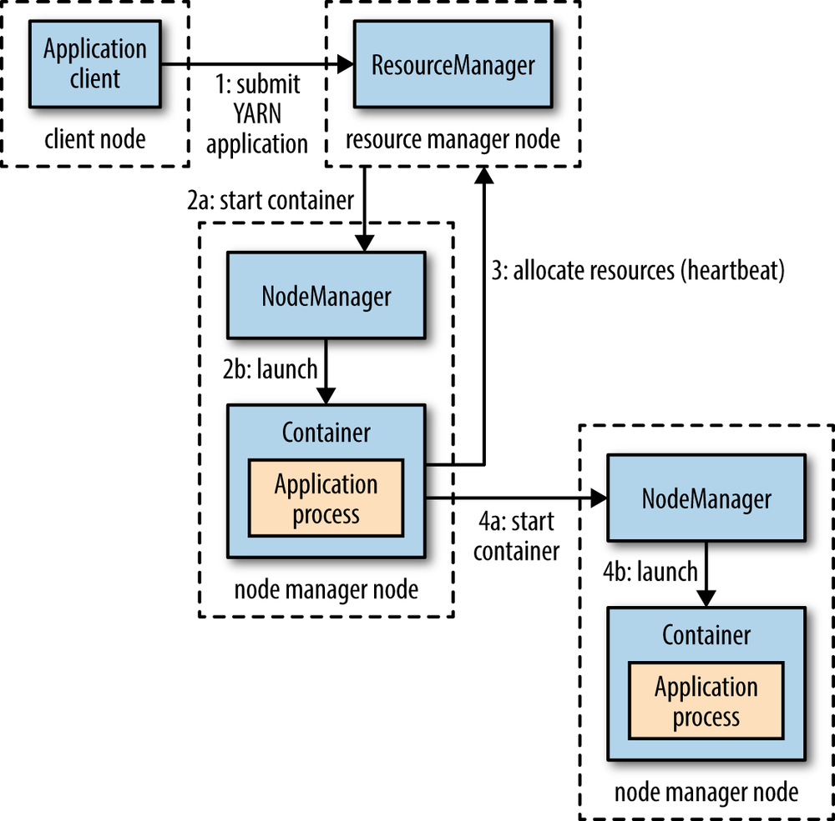
YARN Architecture
YARN provides its core services via two types of long-running daemon
a resource manager (one per cluster) to manage the use of resources across the cluster
and nodemanagers running on all the nodes in the cluster to launch and monitor containers
A container executes an application-specific process with a constrained set of resources (memory, CPU, and so on)
Depending on how YARN is configured a container may be a Unix process or a Linux cgroup

Slide 9
YARN Architecture
A client contacts the resource manager and asks it to run an application master process
The resource manager then finds a node manager that can launch the application master in a container
What the application master does once it is running depends on the application
It could run a computation in the container it is running in and return the result to the client
Or it could request more containers from the resource managers and use them to run a distributed computation
This is what the MapReduce YARN application does
Application
Master
Application
Task

Slide 10
YARN Architecture
In the common case of launching a container to process an HDFS block to run a map task in MapReduce the application will request a container on one of the nodes hosting the block’s three replicas,
A YARN application can make resource requests at any time while it is running
an application can make all of its requests up front
or it can take a more dynamic approach where it requests more resources dynamically to meet the changing needs of the application
Spark takes the first approach, starting a fixed number of executors on the cluster
MapReduce has two phases: the map task containers are requested up front, but the reduce task containers are not started until later.

Slide 11
Caution, Overloaded Terms Ahead
YARN uses some common terms in uncommon ways
When most people hear “container”, they think Docker
In the Hadoop ecosystem, it takes on a new meaning
A Resource Container represents a collection of physical resources such as RAM and CPU cores
It is an abstraction used to bundle resources into distinct and trackable units
In effect a container is a right to use a specified amount of resources

Slide 12
Caution, Overloaded Terms Ahead
“Application” is another overloaded term
Most people think of an application as a process which executes to provide some business capability
In YARN, an application represents a set of one or more tasks that are to be executed to accomplish some overall objective
So tasks are the logical units (processes, threads) of work of applications
An application in this context is also referred to as a type of job
For example, a MapReduce job involves the execution of some number of map and reduce tasks

Slide 13
YARN Architecture Resource Manager
The Resource Manager has two main components
Scheduler
Applications Manager
The Scheduler is responsible for allocating resources to the various running applications
It performs no monitoring or tracking of status for the application
It offers no guarantees about restarting failed tasks either due to application failure or hardware failures.
The Scheduler has a pluggable resource allocation policy which is responsible for sharing cluster resources

Slide 14
YARN Architecture Applications Manager
The Applications Manager is responsible for accepting client requests to execute applications
It negotiates the first container executing the application specific Application Master task
It provides the service for restarting the Application Master task on failure
Receives heartbeat indications from Node Managers to track Worker Node status and availability

Slide 15
YARN Architecture Resource Scheduling Policies
A cluster scheduler essentially has to address:
Multi-tenancy
Users launch many different applications, on behalf of multiple departments or organizations (all of which have some partial “ownership” of the cluster)
A cluster scheduler must share resources in some equitable fashion among these parties
Scalability
A cluster scheduler needs to scale to large clusters running many applications
This means that increasing the size of the cluster should improve performance without negatively affecting system latencies.
Also resource scheduling should not be optimized for any specific application type

Slide 16
YARN Architecture Resource Scheduling Policies
There are two standard modem resource scheduling policies
Fair Scheduler
Allocates resources to weighted pools, with fair sharing within each pool.
Capacity Scheduler
Allocates resources to pools, with FIFO scheduling within each pool
Different vendors default to different scheduling policies
EMR => Capacity scheduler
Cloudera => Fair Scheduler

Slide 17
YARN Architecture Resource Scheduling Policies
The Fair Scheduler is more flexible and allows for jobs to consume unused resources in the cluster
It provides resource guarantees by preempting tasks above the guarantee (fair share) based on defined weights
This makes it a good default for small to medium sized clusters.
The Capacity Scheduler is more rigid, and defines queues with resource quotas
Jobs cannot consume extra resources
This requires more configuration, tuning, and capacity planning
It's generally used on large clusters with lots of different workloads with different needs.

Slide 18
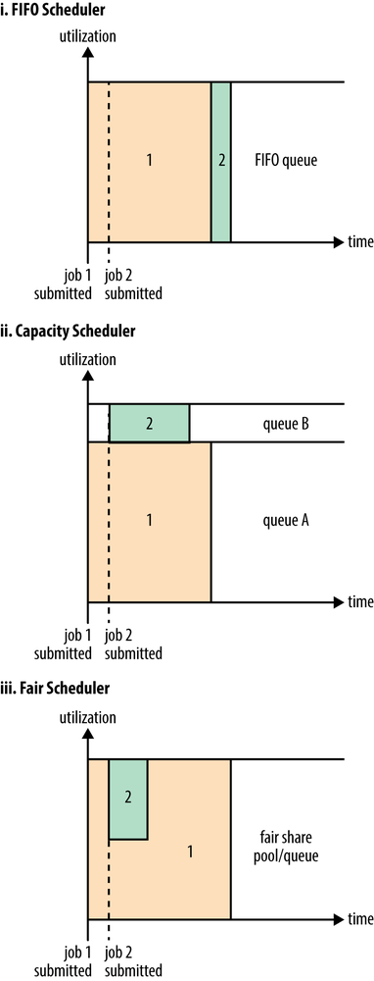
Scheduler Options
With the Capacity Scheduler a separate dedicated queue allows the small job to start as soon as it is submitted, although this is at the cost of overall cluster utilization since the queue capacity is reserved for jobs in that queue
AWS EMR clusters by default are configured with a single capacity scheduler queue and can run a single job at any given time.
With the Fair Scheduler there is no need to reserve a set amount of capacity, since it will dynamically balance resources between all running jobs
Just after the first (large) job starts, it is the only job running, so it gets all the resources in the cluster
When the second (small) job starts, it is allocated half of the cluster resources so that each job is using its fair share of resources

Slide 19
Scheduler Options
The Capacity Scheduler is designed to allow sharing a large cluster while giving each department a minimum capacity guarantee
The central idea is that the available resources in the Hadoop Map-Reduce cluster are partitioned among multiple departments who collectively fund the cluster based on computing needs
There is an added benefit that an department can access any excess capacity not being used by others
This provides elasticity for departments in a cost-effective manner

Slide 20
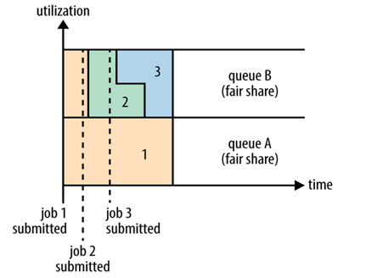
Scheduler Options
Fair scheduling is a method of assigning resources to jobs such that all jobs get, on average, an equal share of resources over time
When there is a single job running, that job uses the entire cluster
When other jobs are submitted, tasks slots that free up are assigned to the new jobs, so that each job gets roughly the same amount of CPU time.
Unlike the default Hadoop scheduler, which forms a queue of jobs, this lets short jobs finish in reasonable time while not starving long jobs

Slide 21
YARN Architecture Node Manager
Per worker node agent tasked with
Overseeing node containers through their lifecycles
Including launching containers (application tasks)
Monitoring node container resource usage
Periodically communicating node liveness to the Resource Manager

Slide 22
YARN Architecture Application Master
Neither the resource manager or the node manager controls overall progress of an application
This makes sense as we want to keep our distributed middleware (Resource Manager and Node Manager) application agnostic
So the question becomes, how is the progress of each application managed?
This is the role of the application specific and custom Application Master task
Each type of application running on Hadoop has its type of Application Master
Each running instance of an application has its dedicated Application Master instance
This instance lives in its own separate container on one of the nodes in the cluster
It is the one container (task) whose initiation is performed by the Resource Manager

Slide 23
YARN Architecture Application Master
Once initiated, an Application Master instance creates other containers (tasks) the application needs to progress
Each application’s Application Master periodically sends heartbeat messages to the Resource Manager
The Application Master oversees the execution of an application over its full lifespan…
From requesting additional containers (resources) from the Resource Manger
To submitting container release requests to the Node Manager on application completion

Slide 24
YARN Application Initiation Overview
Application execution consists of the following steps:
Application submission.
Bootstrapping the ApplicationMaster instance for the application.
Application execution managed by the ApplicationMaster instance

Slide 25
YARN Application Initiation Details
Client Node
Master Node
1: submit
YARN
app
App Client
Resource
Manager
Scheduler
Applications Manager
2: start container
4: register
Client Node
5: allocate
resources
Client Node
Node Manager
Node Manager
3: launch
7: launch
Container
Container
Application Manager
Application Task
6: start
container

Slide 26
YARN Application Initiation Flow
A client program submits the application (job) to execute
The Resource Manager communicates with a Node Manager
The Node Manager allocates a container to start an application specific Application Master
The Application Master, on starting up registers with the Resource Manager
The Application Master negotiates with the Resource Manager for one or more additional resource containers
On successful allocation, the Application Master contacts Node Managers to launch the containers (and tasks)
The Node Managers allocate containers to start application specific tasks

Slide 27
Multi-tenant Hadoop Cluster
Worker Node
MapReduce
Client
Node Manager
submit
mapreduce
job
MR App Master
Spark Task
Map Task
Worker Node
Master Node
Node Manager
Resource Manager
Map Task
Spark Master
submit
spark
job
Worker Node
Node Manager
Spark
Client
Spark Task
Map Task
Reduce Task

Slide 28
Resource Manager Fault Tolerance
Holds a
connection to
Zookeeper
while alive
Master Node
Master Node
Holds a
connection to
Zookeeper
while alive
Active Resource Manager
Failover to standby
RM is active RM
fails
Standby Resource Manager
Active RM writes
Its state
into Zookeeper
Active
Standby
Elector
Active
Standby
Elector
Makes leader selection
based on RM node
connection status
Zookeeper Service
Cluster Node
Cluster Node
Cluster Node
Zookeeper
Zookeeper
Zookeeper

Slide 29
Resource Manager Fault Tolerance
Realized through an Active/Standby architecture
At any point of time, one of the RMs is Active, and one or more RMs are in Standby mode waiting to take over should anything happen to the Active
The trigger to transition-to-active comes from either an admin (manual failover)
Or the integrated failover controller when automatic failover is enabled
To support automatic failover RMs embed the Zookeeper ActiveStandbyElector
This decides which RM should be the Active
When Active goes down or becomes unresponsive another RM is automatically elected to be the Active which then takes over

